Slide 1
Engaging in European Preparations for WTDC-17
Manuel Costa Cabral,
Com-ITU Chair, CEPT co-President
Manuel Costa Cabral
Com-ITU Chair, CEPT co-President
Budva, September 2016

Slide 2
Engaging in European Preparations for WTDC-17
CEPT and ComITU
Recent Activities
A path towards WTDC-17
Budva, September 2016

Slide 3
Engaging in European Preparations for WTDC-17
CEPT and ComITU
Recent Activities
A path towards WTDC-17
Budva, September 2016

Slide 4
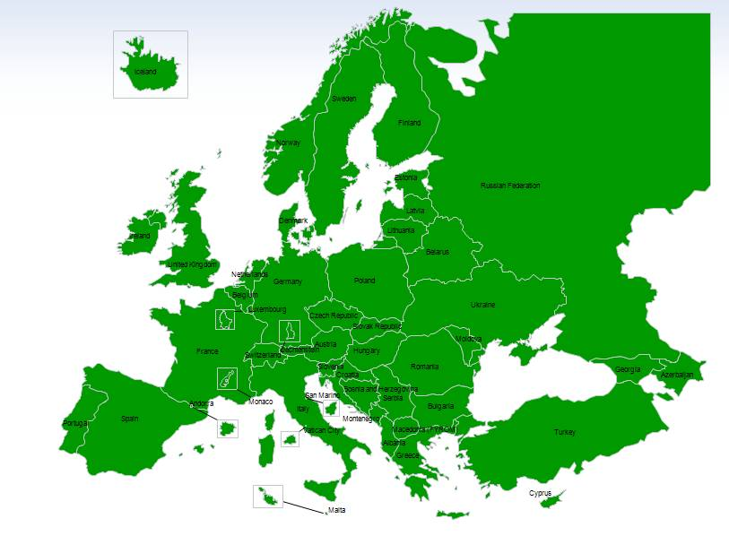
CEPT and ComITU
European Conference of Postal and Telecommunications Administrations (Conférence européenne des administrations des postes et des télécommunications - CEPT) was established in 1959;
Administrations from 48 countries are members of CEPT.
Engaging in European Preparations for WTDC-17 Budva, September 2016

Slide 5
CEPT and ComITU
ECO Council
CEPT Presidency
Com-ITU
CERP
ECC
ECO
Working Groups
Working Groups
Working Groups
CERP: The European Committee for Postal Regulation;
ECC: Expert group within CEPT responsible for developing common policies and regulations in electronic communications and related applications for Europe and harmonising spectrum use;
ECO: Provides advice and support to CEPT to help it to develop and deliver its policies and decisions in an effective and transparent way.
Engaging in European Preparations for WTDC-17 Budva, September 2016

Slide 6
ComITU
The Committee for ITU Policy (Com-ITU) is responsible for organizing the CEPT’s engagement with the ITU for all activities except World Radiocommunication Conferences.
The committee co-ordinates its members’ positions for:
Plenipotentiary Conferences (PP),
World Telecommunication Standardisation Assemblies (WTSA),
World Telecommunication Development Conferences (WTDC),
(…)
The committee also plays an important role in communicating the CEPT’s views to the ITU Council.
Engaging in European Preparations for WTDC-17 Budva, September 2016

Slide 7
ComITU
ComITU
PT ITU-T
PT WTDC-17
PP-18
PT Finantial, Management and Organisation
PT Policy
Engaging in European Preparations for WTDC-17 Budva, September 2016

Slide 8
Engaging in European Preparations for WTDC-17
CEPT and ComITU
Recent Activities
A path towards WTDC-17
Budva, September 2016

Slide 9
ComITU: Recent Activities
Last Meeting. Copenhagen, 6-9 September 2016;
Adopted 14 European Common Proposals to WTSA-16 (Your Administration is still on time to sign them);
Started European preparations for PP-18;
Initiated the European preparations for WTDC-17.
Engaging in European Preparations for WTDC-17 Budva, September 2016

Slide 10
Engaging in European Preparations for WTDC-17
CEPT and ComITU
Recent Activities
A path towards WTDC-17
Budva, September 2016

Slide 11
A path towards WTDC-17
Regional Development Forum
September 2016, BUDVA
ComITU meeting
18-20 January 2017
Copenhagen
RDF + RPM
26-28 April 2017
Vilnius
WTDC-17
9-20 October 2017
Buenos Aires
PT WTDC-17 Webmeeting
22 November 2016
ComITU meeting
24-25 April 2017
Vilnius
ComITU meeting
1st week July
TBC
Engaging in European Preparations for WTDC-17 Budva, September 2016

Slide 12
Engaging in European Preparations for WTDC-17
@
Manuel.costa@anacom.pt
com-itu@eco.cept.org
cept.org/com-itu/
twitter.com/CEPT_ComITU
Budva, September 2016

Slide 13
Engaging in European Preparations for WTDC-17
Share your views!
Share your priorities!
Share your proposals!
Budva, September 2016

Slide 14
Engaging in European Preparations for WTDC-17
Manuel Costa Cabral,
Com-ITU Chair, CEPT co-President
Manuel Costa Cabral
Com-ITU Chair, CEPT co-President
Budva, 27 September 2016

